Slide 1
Addiction Technology Transfer Centers (ATTC)
Humberto M. Carvalho, MPH
Quality Improvement & Workforce Development Branch
CSAT- SAMHSA
Humberto.Carvalho@samhsa.hhs.gov

Slide 2
Technology Transfer
Technology transfer begins during the development of a new technology, continues through its dissemination, and extends into its early implementation. This process requires multiple stakeholders and resources, and involves activities related to translation and adoption. Technology transfer is designed to accelerate the diffusion of an innovation.

Slide 3
ATTC Program Purpose
The purpose of this program is to develop and strengthen the specialized behavioral and primary healthcare workforce that provides substance use disorder treatment and recovery support services.
ATTC Grantees are expected to improve the quality and effectiveness of treatment and recovery by collaborating with SAMHSA and among each other.
The ATTC Network comprises of:
One National Coordinating Office
10 Domestic Regional Centers - located within each HHS region of the U.S.
4 International ATTC Centers

Slide 4
Work Dynamics
The regional centers work under the leadership and coordination by the National Coordinating Office to provide training and other resources aimed at improving the behavioral healthcare workforce’s ability to address substance use disorders, including opioid use disorders.
“The most urgent behavioral healthcare needs of our time require an urgent
response from a highly trained workforce…With these grants, we will create
partnerships and networks to provide the most current training across our
healthcare system.”
Kana Enomoto
SAMHSA Acting Deputy Assistant Secretary, 2016

Slide 5
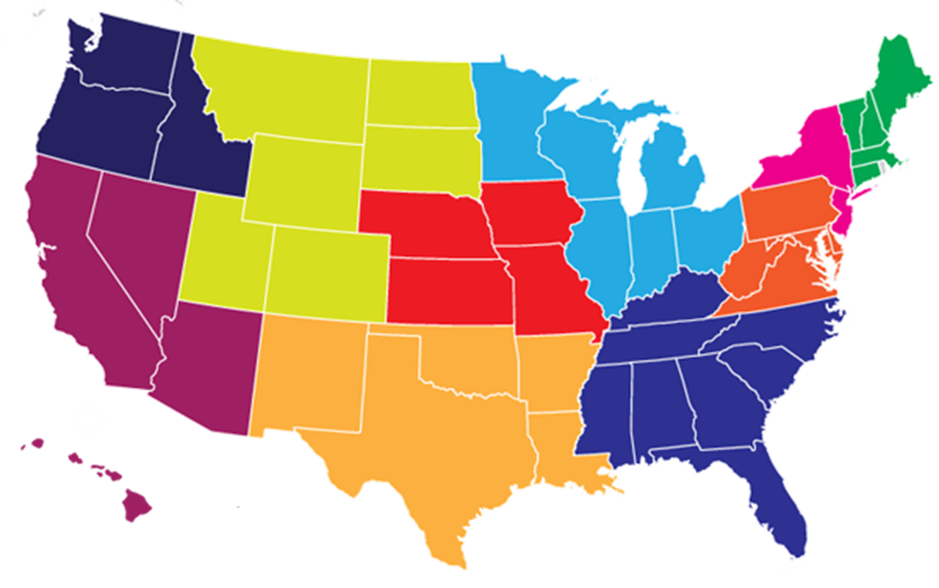
ATTC Network 2017-2022
Mountain Plains ATTC
Univ. North Dakota
Grand Forks
Mid-America ATTC
Truman Med. Ctr. West
Kansas City
ATTC Nat. Coordinating Office
Univ. Missouri Kansas City
Great Lakes ATTC
Univ. Wisconsin Madison
Northwest ATTC
Univ. Washington Seattle
New England ATTC
Brown Univ.
Providence
1
10
2
8
3
5
Northeast & Caribbean ATTC
Nat. Develop. & Res. Inst.
N.Y.
9
7
Pacific Southwest ATTC
Univ. Cal. L.A.
6
4
Central East ATTC
Danya Inst.
Silver Spring
Southeast ATTC
Morehouse School Med.
Atlanta
South-Southwest ATTC
Univ. Texas Austin

Slide 6
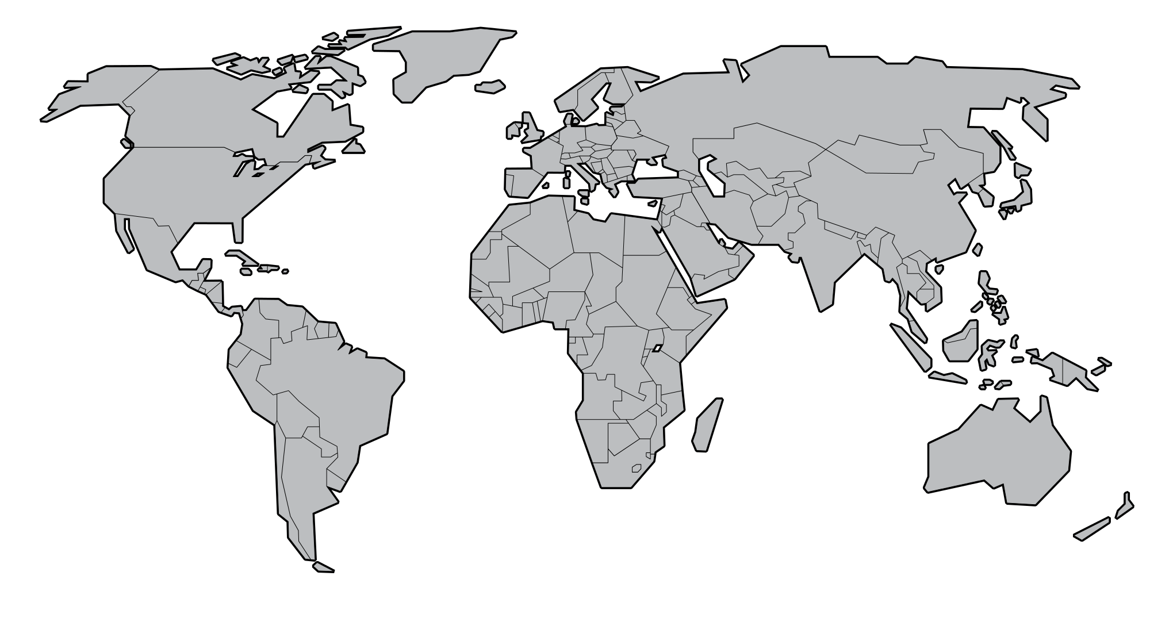
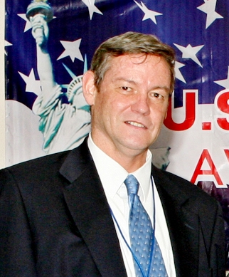
International ATTC Centers
Vietnam ATTC
Univ. California LA
&
Hanoi Medical University
Ho Chi Minh School Medicine & Pharmacy
Vietnam University of Labor & Social Affairs
Ukraine ATTC
Univ. California San Diego
&
Ukrainian Res. Inst. Social & Forensic Psychiatry & Drug Abuse
Southeast Asia ATTC
Univ. California LA
&
Chiang Mai University
Thailand
South Africa ATTC
Brown University – CT
&
University of Cape Town
Nadine Rogers
Kevin Mulvey
Beverley Cummings

