Slide 1
Primary Care Behavioral Health
An introduction to integrated primary care
Jeff Reiter, PhD, ABPP Sep 20, 2023
www.wholeteam.net

Slide 2
Schedule for Today’s Activities
8:30-8:50 Introductions: Your name, the clinic where you are now
8:50-9:00 Breakout group assignments: Introduction to the 5 issues you will help address
9:00-12:00 Didactics
12:00-1:00 LUNCH
1:00-2:30 Didactics
2:30-4:30 Breakout group work: Reply to your 5 questions

Slide 3
Learning Objectives
Explain each component of GATHER
Describe the Quadruple Aim and how it related to integrated care
List at least three ways a BHC can improve primary care
Discuss the rational for warm handoffs and same-day visits
List at least three “Sinkholes” or ”Trampolines” for PCBH

Slide 4
Help me supervise… we’ll come back to these later for your advice
BREAKOUT GROUP #1
“This patient is not really appropriate for primary care. He needs specialty mental health.”
“It’s unethical for me to ask details about his sexual abuse trauma when all I have is 30 minutes.”
“I don’t have much experience with eating disorders so I don’t see those patients.”
“I wish the PCPs would stop asking me to help write all these letters for patients, I’m not a case manager!”
“30 minutes just isn’t enough time for patients to develop a rapport and feel heard.”

Slide 5
Help me provide supervision… we’ll come back to these later for your advice
BREAKOUT GROUP #2
“I mostly do breathing or a handout during the first visit, then we’ll get into more complex stuff at follow-up.”
“My PCPs interrupt me for handoffs, but I wish they wouldn’t; it’s so bad for building rapport with my patients.”
“My new patient reported a lot of relationship problems, so I recommended couples therapy at a nearby agency.”
“We’re doing education with our PCPs about what kinds of referrals are (in)appropriate for a BHC.”
“I got a warm handoff, but the patient only had 10 minutes, so I suggested she come back next week instead.”

Slide 6
Help me provide supervision… we’ll come back to these later for your advice
WHOLE GROUP
“I have a hard time terminating with patients who I know have so much ongoing stress.”
“My patient is super depressed so I promised him that his PCP will get him onto meds that will help.”
“These provider meetings in primary care are so boring. None of it has anything to do with a BHC’s work.”
“Our patients can’t access specialty mental health, so parts of our BHCs’ schedules are blocked for therapy.”
“I give as many interventions as I can in the first visit, in case they don’t show for follow-up.”

Slide 7
The Why
Rationale for Integrating Behavioral Health Into Primary Care

Slide 8
Q: Why Is Integration Occurring?

Slide 9
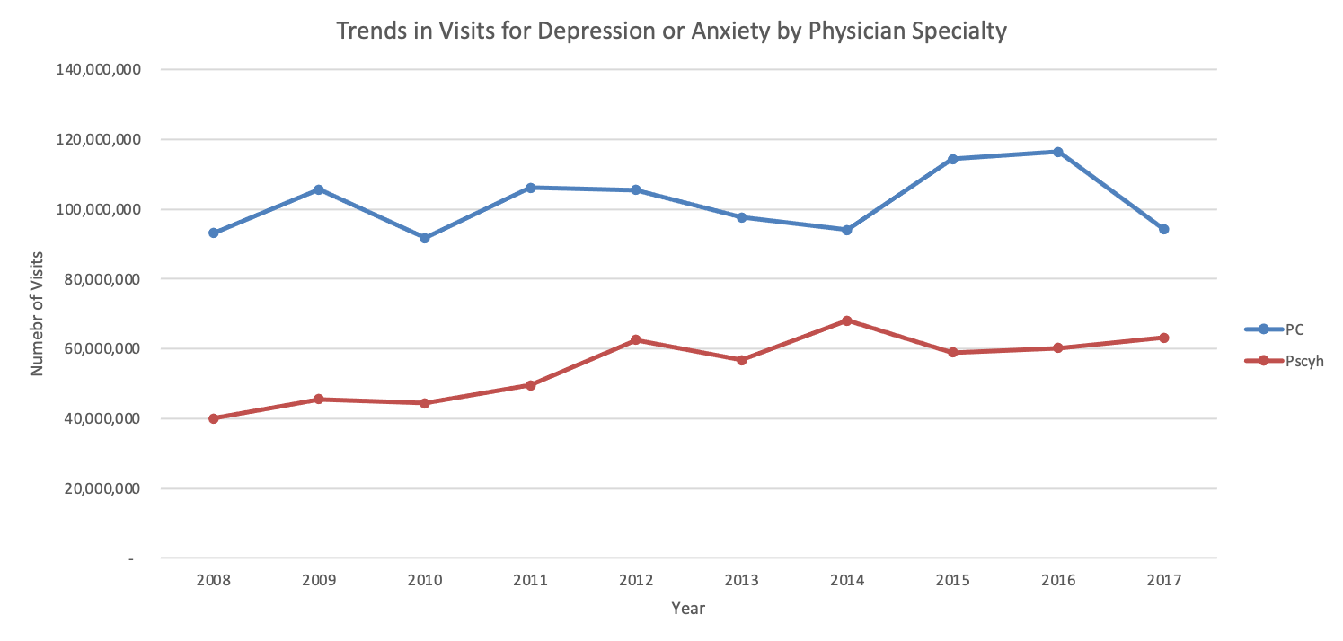
Primary Care: The De Facto Mental Health System (1/3)
Primary care is the “de facto” mental health care system of the country ¹
Notes:
REFERENCE: Robert Graham Center analysis of Medical Expenditure Panel Survey data (2008-2017), available at: https://www.themedicalcareblog.com/primary-care-and-mental-health/
The point here is that PCPs have visits with a lot of patients for depression and anxiety, far more even than psychiatrists.
On the slide, PC stands for Primary Care, Psych stands for Psychiatry

Slide 10
Primary Care: The De Facto Mental Health System (2/3)
Notes:
REFERENCE: Robert Graham Center analysis of Medical Expenditure Panel Survey data (2008-2017), available at: https://www.themedicalcareblog.com/primary-care-and-mental-health/
The point here is that PCPs prescribe a lot of medications for depression and anxiety, far more even than psychiatrists.

Slide 11
Primary Care: The De Facto Mental Health System (3/3)
56% of all mental health care treatment is done in primary care ¹
Visits for antidepressants, anxiolytics/hypnotics, antipsychotics, ADHD meds and bipolar disorder are increasing faster for PCPs than psychiatrists ²
75% of children with a mental health disorder are seen by a pediatrician ³
25% of pediatric primary care and ~ 50% of pediatric visits involve behavioral, developmental, emotional, educational and/or psychosocial concerns ³
Takeaways: Primary care is the main source of mental health care, and integration must assist with the full range of ages and psychiatric conditions
Wang, P.S., Lane, M., Olfson, M., Pincus, H.A., Wells, K.B., et al. (2005). Twelve-month use of mental health services in the United States: Results from the National Comorbidity Survey Replication. Archives of General Psychiatry, 62(6), 629-640.
Olfson, Kroenke, Wan & Blanco (2014). Trends in office-based mental health care provided by psychiatrists and primary care physicians. Journal of Clinical Psychiatry, 75(3), 247-253.
Martini R, Hilt R, Marx L, et al. (2012). Best principles for integration of child psychiatry into the pediatric health health. Guidelines developed for the American Academy of Child and Adolescent Psychiatry.

Slide 12
Mental Health (MH): The Access Problem (1/2)
66% of PCPs report having no access to specialty MH ¹
30% of US population has a MH disorder ², but only 6% visit specialty MH ³
Only 20% of children with a MH problem see a MH provider ⁴
But 75% visit a pediatrician ⁴
Only 34% of adults with a MH problem see a MH provider ⁵
But 86% talk with a health care provider of some sort (e.g., a PCM) ⁵
Cunningham, P. J. (2009). Beyond parity: Primary care physicians’ perspectives on access to mental health care. Health Affairs, 28, 490–501.
Kessler, R.C., Demler, O., Frank, R.G., Olfson, M., Pincus, H.A., et al. (2005). Prevalence and treatment of mental disorders, 1990-2003. New England Journal of Medicine, 352, 2515-2523.
Han, B., Olfson, M., Huang, L. & Mojtabai (2017). National trends in specialty outpatient mental health care among adults. Health Affairs, 36(12), 2062-2068.
Martini R, Hilt R, Marx L, et al. (2012). Best principles for integration of child psychiatry into the pediatric health health. Guidelines developed for the American Academy of Child and Adolescent Psychiatry.
Cohen RA, Zammitti EP. (2016). Access to care among adults aged 18–64 with serious psychological distress: Early release of estimates from the National Health Interview Survey, 2012–September 2015.
Notes:
PRESENTER NOTE: The next slide prompts you to ask attendees for their thoughts on why patients have such trouble accessing MH

Slide 13
Mental Health (MH): The Access Problem (2/2)
Question: What are the barriers to patients accessing specialty MH?
Notes:
PRESENTER: The next slide gives answers to this question

Slide 14
Obstacles to MH Access: Systems and Patient Factors ^{1/2}
Long waitlists, due at least in part to:
Lengthy visits (typically one hour)
Extended follow-up
Limits on MHP’s scope of practice
Restrictions on ages seen
Restrictions on type of problem seen
Patient’s lack of resources
Insurance/Financial limitations (many MHPs are cash-only)
Patient lacks time for ongoing, frequent visits
Lacks accommodations for visits (e.g., childcare, transportation)
Lack of diversity in the MHP workforce
Stigma
Notes:
References (1,2) are on the next slide

Slide 15
Obstacles to MH Access: Systems and Patient Factors ^{1,2}
Better familiarity, comfort with primary care
Primary care in general is familiar to most people (MH is not)
Patients may also be familiar with a specific clinic, staff
Uneven geographic distribution of MHPs (mostly urban, coastal)
Patient views problem as “physical” (low health literacy)
Stress may produce physical symptoms that prompt a PCP (rather than MH) visit
Patients may resist MH referral for perceived physical problem
Takeaway: minimizing these barriers is key to the success of integration
Cunningham, P. J. (2009). Beyond parity: Primary care physicians’ perspectives on access to mental health care. Health Affairs, 28, 490–501.
Mojtabai, R., Olfson, M., Sampson, N.A., Jin, R., Druss, B., et al. (2011). Barriers to mental health treatment: Results from the National Comorbidity Survey Replication (NCS-R). Psychological Medicine, 41(8), 1751-61.

Slide 16
The Frequent Intersection of Health and Behavior (1/2)
Outside of psychiatric conditions, behavior factors into primary care visits in many other ways
Chronic disease management
Diabetes, hypertension, COPD, heart disease, etc.
PCPs assist patients with lifestyle changes
Somatic complaints with lifestyle/stress component
Chronic pain, obesity, chronic fatigue, headaches, etc.
PCPs assist with lifestyle change and counseling for stress
Psychosocial problems
Marital problems, IPV, child behavior problems, grief, etc.
PCPs counsel patients, connect them with resources

Slide 17
The Frequent Intersection of Health and Behavior (2/2)
Outside of psychiatric conditions, behavior factors into primary care visits in many other ways (cont’d)
Preventive health
Tobacco cessation, diet/exercise change, safe sex practices, etc.
PCPs educate, assist patients regarding preventive lifestyle change
Treatment non-adherence
Incorrect use of medications, lack of follow-through on referrals, etc.
PCPs educate, problem-solve with patients to improve adherence
Takeaway: Integrated care must help with more than psychiatric conditions

Slide 18
The Financial Cost of MH Problems
MH conditions can be costly to the system
Patients with psychosocial problems utilize more medical services ¹
Among patients with co-morbid physical and MH conditions:
Total healthcare cost is 2-3 times higher than those with only a physical condition (see next slide)
The most costly 6% of these account for 44% of all healthcare costs ²
Yet only a small percentage of healthcare costs in these patients is MH care – almost all costs are medical care ²
Integrated primary care may reduce costs by 9-17% ²
Takeaway: Improving identification, treatment of MH problems may reduce costs
1. Simon, G., Von Korff, M., Barlow, W. (1995). Health care costs associated with depressive and anxiety disorders in primary care. Archives of General Psychiatry, 52, 850-856.
2. Melek, S. et al. (2018). Potential economic impact of integrated medical-behavioral healthcare. Milliman Research Report.

Slide 19
The Financial Cost of Psychiatric Co-Morbidity ¹
1. Melek, Stephen P, et al. (April 2014). Economic Impact of Integrated Medical-Behavioral Healthcare. Milliman American Psychiatric Association Report.
Notes:
PRESENTER: This chart shows how much more expensive care becomes for various common chronic medical conditions when there is also a psychiatric co-morbidity. The point here is that if we can do better with treating psychiatric conditions, we can improve the cost of healthcare. IMPORTANT: Data derived from a commercial pay population and does not include patients with substance abuse and/or severe, persistent mental illness

Slide 20
Primary Care Takes a Team
The work of a PCP has become too involved for one person
10 or 15 minutes per visit is common
On average, patients have 3 complaints per visit ¹
Insufficient training in behavioral interventions ^{2, 3}
Over 3 dozen urgent but unpaid tasks everyday ⁴
Insufficient time for completing all recommended preventive ⁵ and chronic care ⁶
No clear organic etiology to many presenting complaints ⁷
There is a shortage of PCPs nationally ⁹
Takeaway: Integrated care must involve a team approach that subtracts from the PCP workload and improves the team’s behavior change skills
Notes:
1. Beasley, J.W., Hankey, T.H., Erickson, R., Stange, K. C., Mundt, M., et al. (2004). How many problems do family physicians manage at each encounter? Annals of Family Medicine, 2, 405-410.
2. Foster, G., Wadden, T., Makris, A., Davidson, D., Sanderson, R., et al. (2003). Primary care physicians’ attitudes about obesity and its treatment. Obesity Research, 11, 1168-1177.
3. Horwitz, S.M., Storfer-Isser, A., Kerker, B.D. et al. (2015). Barriers to the identification and management of psychosocial problems: changes from 2004 to 2013. Academic Pediatrics, 15(6), 613-620.
4. Baron, R.J. (2010). What’s keeping us so busy in primary care? New England Journal of Medicine, 362, 1632-1636.
5. Yarnall, K.S., Pollack, K.I., Ostbye, T., Kraus, K.M., Michener, J.L. (2003). Primary care: is there enough time for prevention? American Journal of Public Health, 93(4), 635-641.
6. Yarnall, K. S., Krause, K. M., Ostbye, T., Pollak, K. I., Gradison, M., et al. (2005). Is there time for management of patients with chronic diseases in primary care? Annals of Family Medicine, 3(3), 209-14.
7. Kroenke, K., & Mangelsdorff, A. (1989). Common symptoms in primary care: Incidence, evaluation, therapy and outcome. American Journal of Medicine, 86, 262-266.
8. Bureau of Labor Statistics, U.S. Department of Labor (2014). Occupational Outlook Handbook, 2014-2015 Edition, Physicians and Surgeons. http://www.bls.gov/ooh/healthcare/physicians-and-surgeons.htm. Accessed 29 July 2014.
9. Petterson et al. (2012). Projecting US primary care physician workforce needs, 2010-2025. The Annals of Family Medicine, 10(6), 503-09.

Slide 21
To Recap…
Integration is occurring because:
High volume of care-seekers
Frequent intersection of behavior/health
Economics
Primary care’s need for help

Slide 22
The How
The Structure of Integrated Care

Slide 23
Integrated Care Emerges
The move to integrate behavioral health services into primary care emerged synergistically with related movements
The Patient-Centered Medical Home (PCMH) was first proposed in 2002 as a means of transforming primary care ¹
In 2008, the Triple Aim laid out goals for improving the US healthcare system ²
In 2014, the Quadruple Aim expanded the goals of the Triple Aim ³
In 2022, the Quintuple Aim was proposed ⁴
These movements, and the realities outlined in earlier slides, led to the emergence of integrated care. Let’s take a closer look these movements…
1. American Academy of Pediatrics. (2002). The medical home: Medical home initiatives for children with special needs project advisory committee [policy statement]. Pediatrics, 110, 184–186.
2. Berwick, D. M., Nolan, T. W., & Whittington, J. (2008). The triple aim: Care, health, and cost. Health Affairs, 27, 759–769.
3. Bodenheimer, T., & Sinsky, C. (2014). From triple to quadruple aim: Care of the patient requires care of the provider. Annals of Family Medicine, 12, 573–576.
4. Nundy, S., Cooper, L.A. & Mate, K.S. (2022). The Quintuple Aim for health care improvement. JAMA, 327(6), 521-22.

Slide 24
Question: What is primary care?

Slide 25
Defining Primary Care (1996)
Primary care is defined as: “…integrated, accessible health care services provided by clinicians who are accountable for addressing a large majority of health care needs, developing sustained partnership with patients, and practicing in the context of family and community.” ¹
Institute of Medicine (1994). Defining Primary Care: An Interim Report. National Academy Press: Washington, DC.

Slide 26
Defining Primary Care (1996)
A closer look at the definition
Integrated: takes a holistic view of health and health care
Accessible: as the front-line resource for health care, access is critical
Accountable: coordinates, facilitates the care of specialists and others
Majority of health care needs: generalists providing birth-to-death care
Sustained partnership: collaborative approach to care often lasting years
Context of family and community: aims to understand the context of patients’ lives and operates accordingly
Primary care is unique in the healthcare system. No other part of healthcare has the same goals, functions and attributes

Slide 27
Defining Primary Care (2021)
High-quality primary care is the provision of whole-person, integrated, accessible, and equitable health care by interprofessional teams that are accountable for addressing the majority of an individual’s health and wellness needs across settings and through sustained relationships with patients, families, and communities.
National Academies of Sciences, Engineering, and Medicine (2021). Implementing high-
quality primary care: Rebuilding the foundation of health care. Washington, DC:
The National Academies Press. https://doi. org/10.17226/25983.

Slide 28
The 4 C’s of Primary Care
Primary care can also be summarized with the 4 C’s:
Comprehensive care (generalist care for both prevention and treatment)
first Contact of care (entry point to care)
Coordination of care (coordinates and integrates specialty care)
Continuity of care (longitudinal care, built on a strong patient-provider relationship)

Slide 29
Primary Care Services
Preventive health care
Physicals visits (well-child, adult, Medicare Annual Wellness Visit)
Procedures (e.g, pap smears, immunizations)
Front line for acute care
Chronic disease management (e.g., diabetes, hypertension, COPD, asthma, heart disease, depression/anxiety, obesity)
Provide a “medical home”
Settings
Clinic, hospital, ED, nursing home, assisted living, in-home visits
Vast majority work in a single clinic setting ¹
1. Petterson, S., McNellis, R., Klink, K., Meyers, D., Bazemore, A. (2018). The State of Primary Care in the United States: A Chartbook of Facts and Statistics. Accessed 1/15/2021 at https://www.graham-center.org/content/dam/rgc/documents/publications-reports/reports/PrimaryCareChartbook.pdf
Notes:
1. Robert Graham Center analysis of 2017 FM Medicare Physician Supplier data. The vast majority of FM physicians work in a clinic, and only in one clinic. A much smaller number work in more than one setting or in settings other than a clinic.

Slide 30
The Patient-Centered Medical Home (PCMH): Definition
The “Patient-Centered Medical Home” (PCMH) transforms primary care in various ways ¹
Team-based model of service delivery
Utilizes registries to track care of certain populations
Takes a holistic approach to care
Emphasizes self-management of health
Optimizes data to track disease outcomes and care quality
Uses care coordinators to help navigate and integrate specialty care
Encourages payment based on improved outcomes, decreased costs
Shifts care from a reactive mode (best for acute problems) to proactive, coordinated care (better for chronic and preventive care)
1. McDaniel, S. H., & deGruy, F. V. (2014). An introduction to primary care and psychology. American Psychologist, 69, 325–331.
Notes:
The PCMH sometimes goes by other names, such as “Health Home”
Note that members of a primary care team vary from clinic to clinic (see slide 7)
Note that in the MHS, the PCMH also incorporates medical readiness and deployment health

Slide 31
The Patient-Centered Medical Home (PCMH): Goals
The “Quintuple Aim” is
the North Star of the
PCMH
The goal is to optimize primary care
^{to meet the Quintuple Aim}

Slide 32
Integrated Care Approaches

Slide 33
Integrated Care Approaches
Beginning in the 1990s, various approaches developed for integrating behavioral health into primary care
Co-Located Therapy
Primary Care Behavioral Health model (PCBH)
Population-specific approaches
Collaborative Care model (CoCM)
Medication-Assisted Treatment (MAT)
Screening Brief Intervention and Referral to Treatment (SBIRT)
Let’s explore some of these in a bit more detail on the subsequent slides

Slide 34
Question: What is a co-located therapy approach?

Slide 35
Integrated Care Approaches: Co-Located Therapy
Background
Representative of early integration efforts (though some systems still utilize this approach)
Overview: this is specialty mental health provided in primary care
Advantages
Increased opportunities for PCP and MH collaboration
Increased access to MH care
Limitations
Similar to those of regular specialty care
For example - poor access, limited MH provider scope, limited coordination of care with PCP, etc.

Slide 36
Question: What is the Collaborative Care Model?

Slide 37
Integrated Care Approaches: Collaborative Care Model (CoCM)
Background
Focused on specific populations (typically anxiety, depression)
Uses a registry to track care
“Care coordinator/manager” delivers brief phone-based behavioral interventions, psychiatric prescriber provides oversight
Patients are “treated to target” using standardized tools
This is the second of two approaches used in the DoD
Advantage: Follow-up tracking helps keep patients engaged in care
Limitations:
Limited capacity (i.e., the lengthy follow-up typically required for treating to target results in limits on the number of patients followed)
Limited scope (i.e., only used with a few select conditions)

Slide 38
Integrated Care Approaches: Other Approaches
Medication-Assisted Treatment (MAT)
Goal: treat opioid use disorder in primary care using suboxone
Overview: PCPs with specialized training provide structured care
Screening Brief Intervention and Referral to Treatment (SBIRT)
Goal: prevent risky substance use from becoming problematic
Overview: universal screening for risky substance use, followed by brief behavioral interventions by a trained PCP (or other) for patients who screen positive
Many clinics integrate care idiosyncratically, using no clear model or an approximation of a recognized model

Slide 39
Question: How would you describe the PCBH model?

Slide 40
Integrated Care Approaches: Primary Care Behavioral Health (PCBH)
Background
Overview: Team-based primary care approach to managing behavioral health conditions. Adds a “BHC” to the team
Goal: Enhance the primary care team’s ability to manage and treat such conditions, with resulting improvements in primary care for the entire population
This is the model you are utilizing
Advantages: Goals and practices promote an easy fit with primary care
Limitations: No systematic tracking means patients can be lost to follow-up

Slide 41
In Sum…
Primary care has a unique role to play in the healthcare system, and engages in unique ways with patients
The role of behavior in health is ubiquitous, and primary care needs help addressing the behavior change needs of patients
Primary care is transitioning to team-based care (the ”Patient-Centered Medical Home”) to meet the goals of the Quintuple Aim
Different approaches have been used to integrate behavioral health providers into primary care teams

Slide 42
The PCBH model

Slide 43
The How? The PCBH Model
Why focus on improving primary care broadly?
Primary care has high value if done well
Better health outcomes
Fewer healthcare disparities
Lower healthcare costs
But…behavioral issues of patients hinder primary care
Longer visits
High stress
This negatively affects care for all
Thus, improving management of behavioral issues in primary care is key to helping primary care realize it’s potential – for all

Slide 44
The How? The PCBH Model
How can a BHC help primary care broadly?
See patients before the PCP (reduce PCP visit time)
Or assist during the visit
See patients instead of the PCP (improve access)
Complete certain activities such as anticipatory guidance, cognitive screens (improve PCP efficiency)
Assist with miscellaneous care needs (reduce PCP stress)
Co-lead group medical visits (improve PCP productivity)
Remember the Quintuple Aim!
Help develop metrics to track disparities (ensure health equity)

Slide 45
Question: What is GATHER and what does it stand for?

Slide 46
The How? The PCBH Model
Components (GATHER)
Generalist
Accessible
Team-based
High productivity
Educator
Routine
Clinical structure
30-minute visits
Consultant follow-up

Slide 47
Question: What are the differences between a ”consultant” and a “therapist”?

Slide 48
The Behavioral Health Consultant (BHC)
Dimension | BHC | Therapist
Primary consumer | PCP | Patient/Client
Care context | Team-based | Autonomous
Accessibility | On-demand | Scheduled
Ownership of care | PCP | Therapist
Referral generation | Results-based | Independent of outcome
Productivity | High | Low
Problem scope | Wide | Narrow/Specialized
Termination of care | Patient progressing twd goals, has plan | Patient has met goals
Notes:
Kirk

Slide 49
PCBH Model Nuts and Bolts
Notes:
Jeff

Slide 50
BHC Location
Notes:
Jeff

Slide 51
Location Option #1 (Optimal)
Shared Exam Room + Separate Workstation
Notes:
Jeff

Slide 52
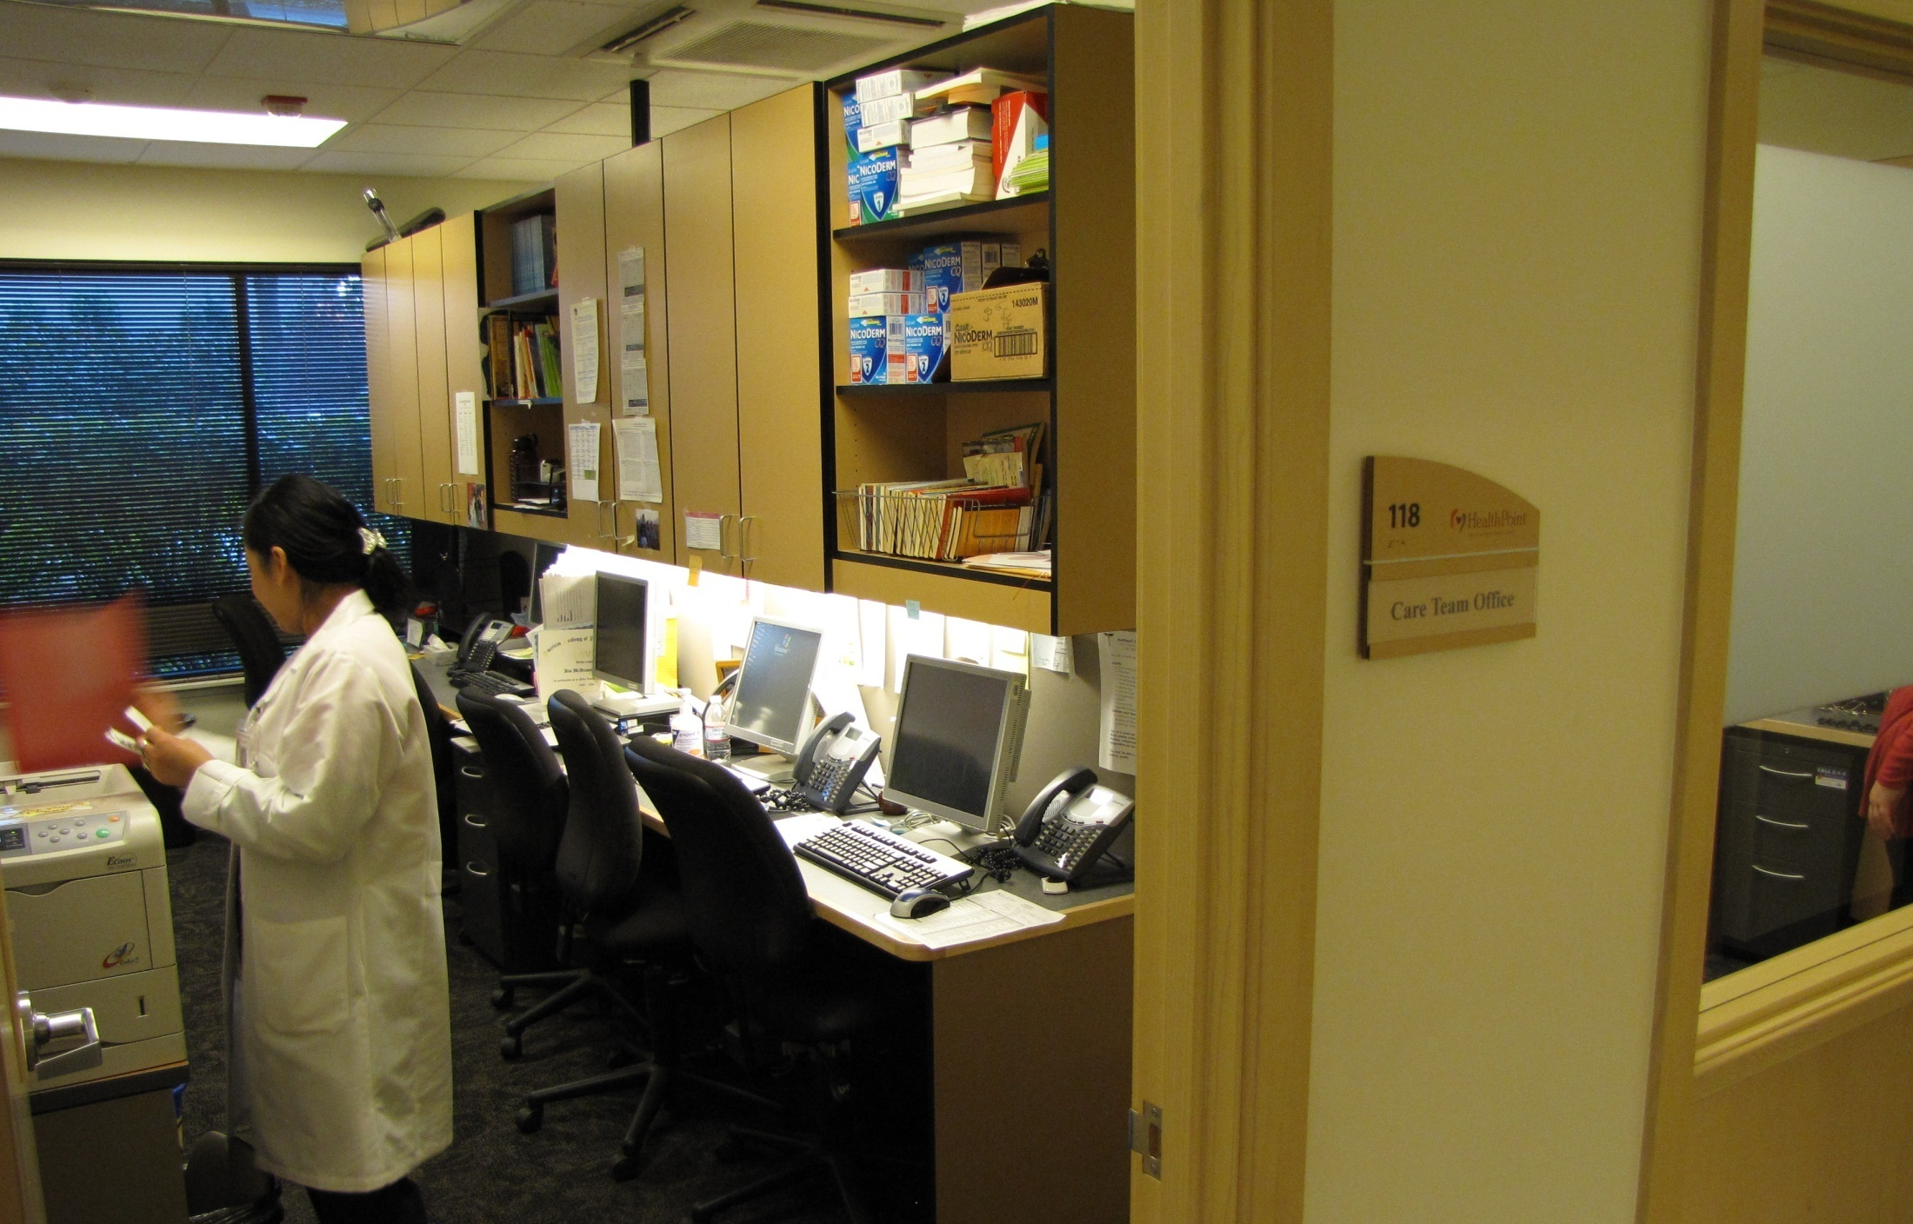
Notes:
Jeff

Slide 53
Location Option #2
Dedicated Exam Room
Notes:
Jeff

Slide 54
Location Option #3
Dedicated Office Space
Notes:
Jeff

Slide 55
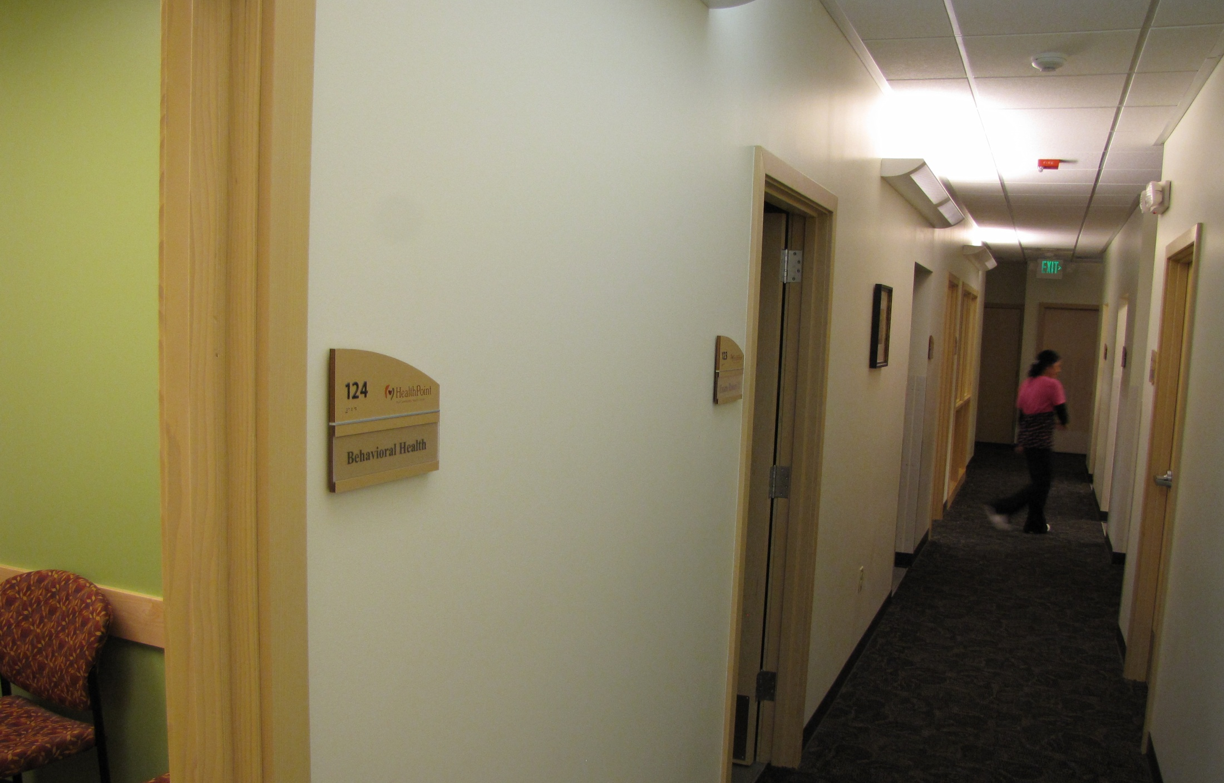

Slide 56
Warm-Handoff Video
Notes:
Jeff (Kim add comment about talking in hall then ask if comments or questions)

Slide 57
Day in the Life of a BHC
Notes:
Jeff

Slide 58
The BHC’s Template
Time | Appt Type* | Time | Appt Type*
9:00 | FTR | 1:00 | FTR
9:30 | FTR | 1:30 | FTR
10:00 | FTR | 2:00 | FTR
10:30 | 24HR | 2:30 | 24HR
11:00 | FTR | 3:00 | FTR
11:30 | FTR | 3:30 | FTR
12:00 | Lunch | 4:00 | FTR
12:30 | Lunch | 4:30 | FTR
* Note the proportion of FTR vs 24HR slots varies based on many factors such as BHC experience level
* Note also that start/stop times of visits may not match the schedule
Notes:
Jeff

Slide 59
Sample Clinic Day: What to Look For
Timing of BHC visit *
Before, after and with PCP
Variety of problems and ages
Clinical (“mental” and “physical” conditions, all ages)
Care management/coordination
Variety in the goals of visits
Helping manage the patient
Helping treat the patient
Mix of scheduled and same-day visits
* Note the flexible visit length and start/stop times for visits
Notes:
Jeff

Slide 60
Sample Clinic Day
9:00 (8:55-9:25)
PCP wants diagnostic guidance for medication selection
52 y/o homeless, ? ADHD vs. bipolar
9:30 (9:30-9:50)
Question re disability expiring
64 y/o Russian-speaker, depression
10:00 (9:55-10:30)
PCP says “I don’t know her problem”
62 y/o, psychiatrist d/c’d, on 3 meds from 3 Drs
10:30 (10:45-11:00)
Open→Same-day w/ PCP in exam room
12 y/o autism, ADHD, recently showing tics, hallucinations
Notes:
Jeff

Slide 61
Sample Clinic Day (cont’d)
11:00 (11:15-11:35)
N/S → Same-day to prep for PCP visit
6 y/o ADHD, insomnia, enuresis
11:30 (11:40-12:10)
Planned f/u from 1 week earlier
20 y/o Spanish-speaker, depressed w/ SI
2:00 (2:05-2:25)
Cx → Same-day visit with BHC instead of PCP
65 y/o for smoking cessation/NRT refill
2:30 (2:50-3:10)
Open → warm-handoff to complete medication agreement
60 y/o severe etoh, chronic arm pain
12:00 Lunch
1:00 Team meeting (15-min talk on pain, 5-min on tobacco cessation)

Slide 62
Sample Clinic Day (cont’d)
3:00 (3:15-3:40)
Planned f/u after 2 weeks
47 y/o homeless, MDD w/ psychosis, acute SI due to meds
3:30 (3:40-3:55)
Planned f/u after 1 month
45 y/o homeless, MDD, trying to get disability
4:00 (4:10-4:40)
Cx → Warm-handoff to assist with PCP visit
16 y/o expelled from school, needs risk assessmt
4:30 (4:45-5:10)
Open → Same-day f/u after 4 mos
20 y/o seeking disability for PTSD, dep

Slide 63
Making It Work: The Sinkholes and The Trampolines

Slide 64
Reiter’s Top 10 Sinkholes and Trampolines
Sinkholes
Isolated location
Passive approach
Triage and refer
Inefficient warm handoffs
Meet-and-greets
Trampolines
Be central and visible
Do today’s work today
Believe in primary care
Limit PCP and room time
Be flexible with visit length

Slide 65
Reiter’s Top 10 Sinkholes and Trampolines
Sinkholes
Over-emphasize BHC interventions
Limit problem scope
Emphasize time (more=better)
Treat “diseases”
Have low expectations for BHC (“nicety”)
Trampolines
Emphasize ways to help the PCP/team
Be a generalist (learn)
Emphasize access
Teach skills
Have high expectations for BHC (“necessity”)

Slide 66
Team-based care Strategies

Slide 67
Team-Based Care Rationale
PCPs will always see more patients than BHCs
Remember the Quintuple Aim
Improved health outcomes
Improved patient experience
Lower health costs
Improved health equity
Improved provider experience
Improving the efficiency and effectiveness of the PCP and team will fulfill the Quintuple Aim

Slide 68
Sample Team-Based Care Targets
Improved PCP access
Increased PCP visit time
Decreased PCP and team stress
Decreased PCP turnover
Increased PCP job satisfaction
Improved PCP and team confidence for working with behavioral issues
Increased PCP and team skill for working with behavioral issues
Improved PCP and team perceived support for working with behavioral issues
Increased clinic revenue
Improved quality metrics for the clinic
Improved patient satisfaction

Slide 69
PCBH Teamwork Example (1/5)
A BHC learned how to provide preventive education (aka “anticipatory guidance”) during well-child checks, then received regular warm handoffs to complete this when PCPs were running behind. This resulted in patients receiving more anticipatory guidance than the PCP typically had time to provide, and allowed the PCP to have more time with other patients.

Slide 70
PCBH Teamwork Example (2/5)
A PCP was running late to see a man presenting for depression, so her MA (with the PCP’s permission) engaged the BHC to see the patient first while the PCP met with a different patient. The BHC completed a visit and communicated pertinent history, impressions and recommendations to the PCP. The PCP was then able to complete her visit for the patient with depression efficiently to run on time for later patients.

Slide 71
PCBH Teamwork Example (3/5)
A patient with PTSD asked his PCP (during a visit for a diabetes check) to complete paperwork to help him get disability for the PTSD. The paperwork involved 8 pages of questions for the provider, who was already running behind on his schedule for the day. The PCP paged the BHC for a warm handoff, the goal being to have the BHC complete the disability paperwork. When the PCP visit was finished, the BHC saw the patient. She completed adequate assessment to enable her to complete the paperwork; then she and the PCP co-signed the paperwork. The patient left satisfied and the PCP was able to save time that they spent with the next patient.

Slide 72
PCBH Teamwork Example (4/5)
A PCP was called by a teenage patient’s school who wanted to discuss some behavioral concerns the patient was having. The PCP was willing to call but had a very busy day, so she asked the BHC to call instead. The BHC was able to talk with the teacher to hear the concerns, and then worked with schedulers to get the patient back-to-back appointments with the BHC and PCP on the same day. The BHC also sent the school a Vanderbilt screener to complete in advance of the visit.

Slide 73
PCBH Teamwork Example (5/5)
A patient presented with a new behavioral concern. The PCP gathered initial history then paused the visit for a warm introduction to the BHC. The PCP then proceeded to his next patient while the BHC conducted a visit with the handoff patient. The BHC then reconnected with the PCP to discuss impressions and a plan, after which the PCP completed the visit with the handoff patient. This process enabled good teamwork and allowed the PCP to remain generally on time for his other patients.
Notes:
NOTES: Teamwork like this can take some time to form. There must be a mutual understanding between BHC and PCP of roles and expectations; trust in each other; and clear communication. This is an example of teamwork to strive for.

Slide 74
Most Important….Keep the Focus
Remember the goal of making primary care better
(for everyone)
Think like a primary care team member
Population goals

Slide 75
Small-Group Discussion
Discuss your group’s questions separately then we’ll reconvene

Slide 76
Help me supervise… we’ll come back to these later for your advice
BREAKOUT GROUP #1
“This patient is not really appropriate for primary care. He needs specialty mental health.”
“It’s unethical for me to ask details about his sexual abuse trauma when all I have is 30 minutes.”
“I don’t have much experience with eating disorders so I don’t see those patients.”
“I wish the PCPs would stop asking me to help write all these letters for patients, I’m not a case manager!”
“Our patients can’t access specialty mental health, so parts of our BHCs’ schedules are blocked for therapy.”

Slide 77
Help me provide supervision… we’ll come back to these later for your advice
BREAKOUT GROUP #2
“I mostly do breathing or a handout during the first visit, then we’ll get into more complex stuff at follow-up.”
“I give as many interventions as I can in the first visit, in case they don’t show for follow-up.”
“My PCPs interrupt me for handoffs, but I wish they wouldn’t; it’s so bad for building rapport with my patients.”
“My new patient reported a lot of relationship problems, so I recommended couples therapy at a nearby agency.”
“We’re doing education with our PCPs about what kinds of referrals are (in)appropriate for a BHC.”

Slide 78
Help me provide supervision… we’ll come back to these later for your advice
WHOLE GROUP
“I got a warm handoff, but the patient only had 10 minutes, so I suggested she come back next week instead.”
“I have a hard time terminating with patients who I know have so much ongoing stress.”
“30 minutes just isn’t enough time for patients to develop a rapport and feel heard.”
“My patient is super depressed so I promised him that his PCP will get him onto meds that will help.”
“These provider meetings in primary care are so boring. None of it has anything to do with a BHC’s work.”

Slide 79
Jeff Reiter, PhD, ABPP
www.wholeteam.net
ADDITIONAL QUESTIONS?
THANK YOU and ENJOY THE REST OF YOUR YEAR!

