Slide 1

2023-2024 Supervisor Orientation

Slide 2
Agenda
09:30 – 10:00: Supervisor Resources
General Updates and Reminders
--Break--
10:10 – 11:00: Manual and Process Updates
--Break--
11:10 – 12:00: Policies of Importance
--Lunch--
01:00 – 05:00: Supervisor CE Training (Drs. Sconyers and Asay)

Slide 3
Supervisor Resources
Supervisor Resources Page:
  https://psychologyinterns.org/interns-supervisors/central-region-supervisors/
  Password: nptcsup17
  Copies and examples of forms and evaluations
  Time tracking instructions and resources
  Supervisor cheat sheets and best practices
  Reference materials (manual links, bylaws, MPA)

Slide 4
Supervisor Resources
Training year calendar
  On the resources page, if you click on “View Full Calendar” you will be able to see what is coming up for interns as well as supervisors.
  This will also show you due dates for timesheets and various surveys/tasks throughout the year.
  From here you can also subscribe to the calendar or export its contents for Google or Outlook.

Slide 5
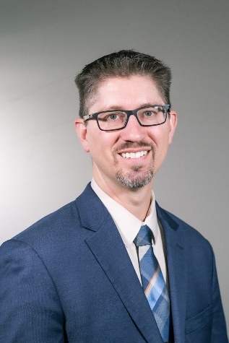
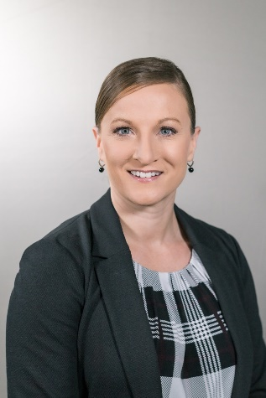
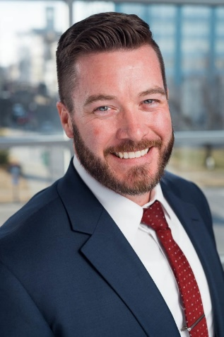
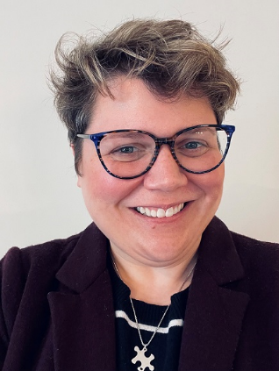
NPTC Leadership
President/CEO
Adam Andreassen, Psy.D.
aandreassen@psychologyinterns.org
Regional Training Director
Dustin Brown, Psy.D.
dbrown@psychologyinterns.org
Director of Special Projects
Angela King, Psy.D.
aking@psychologyinterns.org
DEI Regional Consultant
Tosha Larson, Ph.D.
tlarson@compasshn.org

Slide 6
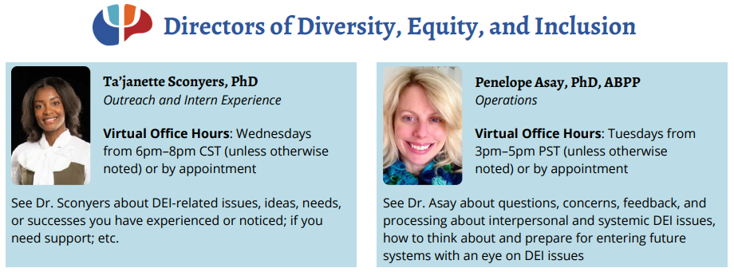
NPTC Leadership

Slide 7
Supervisor Resources
Diversity and Inclusion resources are located on our website: https://psychologyinterns.org/about-nptc/diversity-and-inclusion/
  Bios for our diversity committee
  Definition of Rural Psychology
  Long-Term Diversity Plan
  Disability and Support Services
  Non-Discrimination Policy
  Contact form for the Diversity Committee (make training requests and/or ask questions)

Slide 8
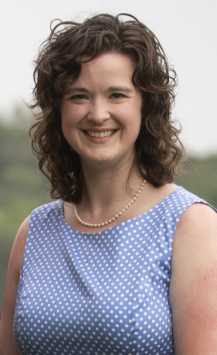
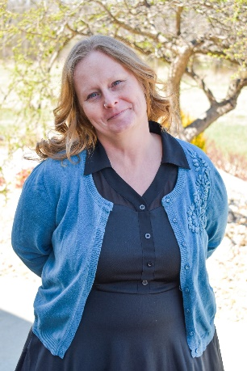
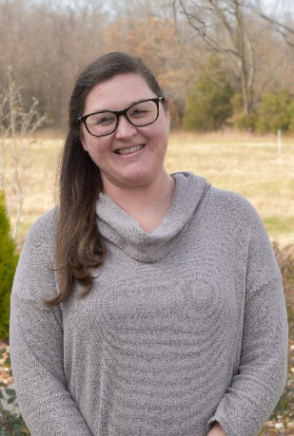
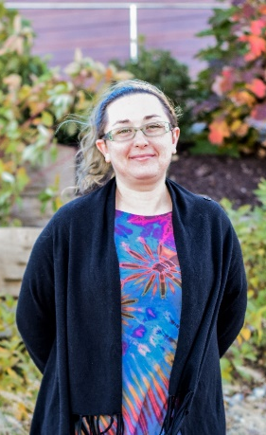

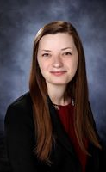
Meet the Team
Director of Operations
Katherine Dixon
kdixon@psychologyinterns.org
APA accreditation
HRSA grant
NPTC policies
Forms and processes
Membership requirements
Operations Coordinator
Toni Ripper
tripper@psychologyinterns.org
Hour audits
Graduation progress
School communications
HR communications
APPIC match process
Operations Assistant
Audrey DeMate
ademate@psychologyinterns.org
Survey submissions
Timesheets / Time Tracking
Supervisor additions/removals
Data Reporting
Admin Assistant
Amber Bartley
abartley@psychologyinterns.org
Communication “hub”
Resetting/unlocking passwords
Invoicing / financials
Meeting scheduling
Training Coordinator
Shannon Estabrook
sestabrook@psychologyinterns.org
Didactic training
Didactic makeup
CE trainings/homestudy courses
Communications Coordinator
Mallory Richardson
mrichardson@psychologyinterns.org
Website maintenance
Marketing materials/posts/updates
Intern social events
Internship verification
Licensure paperwork
Regional newsletters
  As always, we are all always available to answer whatever questions you have no matter who you contact.

Slide 9
Supervisor Resources
Training Year Dates: July 24th, 2023 – July 23rd 2024
Current salaries: $31,200 - $37,500
  Current allowable range: $29,000 - $37,500
  Allowable ranges will be discussed by the board annually and provided to sites as an addendum to the MPA for record keeping.
  List of individual site salaries is available on the website.

Slide 10
Supervisor Resources
FAQ Guides
  Existing guides include:
    Timesheet FAQs and Cheat Sheet
    Supervision Cheat Sheet
    Running Reports
    PIP Best Practices
    Example ILTP, Action Plans, PIPs
  What additional FAQs, examples, or video tutorials would be helpful for you?

Slide 11
General Updates and Reminders
Adhering to Deadlines
  As a general reminder, please do your best to adhere to task deadlines as assigned. Most of our deadlines are set on specific dates for a reason, and are associated with tasks we need to complete by a specific date as well.
  If you know you can’t meet a deadline, please communicate that with us as soon as you know and provide a date that you can complete the task. In some cases we might be able to send the survey a few days early to avoid conflicts, so please reach out.
  Changes in assignment sending times or deadline extensions should be the exception, not the rule.
If you have any suggestions or feedback on timeline of requests, please let us know.

Slide 12
*General Updates and Reminders
Didactic Training
  Sites must provide interns access to remote technology needed for virtual didactics
  Intern travel policy in effect for in-person days
  Most Fridays from 8:00 am – 12:00 pm
    Orientation and four additional training days will be in person from 8:30 am – 4:30 pm
    July 27th (Springfield) November 3rd (Springfield)
    July 28th (Springfield) April 5th (Jeff City)
    September 29th (Jeff City) June 7th (Springfield)
    The following are dates not currently scheduled to have didactics (schedule subject to change based on presenter availability)
        November 4th (GL) December 23rd
        November 11th (CEN) December 30th
        November 25th July 21st

Slide 13
General Updates and Reminders
Didactic Training cont.
  IHC Didactics will be held virtually on the following Wednesdays from 8:30 – 4:30:
    August 16th December 13th April 17th
    September 13th January 17th May 15th
    No October IHC February 14th June 19th
    November 15th March 13th No July IHC
  Sites should determine in advance where the interns should be on didactic days
    Our expectation is they attend virtual didactics from their office unless other arrangements are approved by the site.
    If interns are allowed to stay home on Fridays, sites should provide clear expectations of what they should be doing after didactics.

Slide 14
General Updates and Reminders
Site Visits
  Every year following the first quarter site feedback the Regional Training Director conducts site visits to go over the feedback.
  Every three years the site visits are conducted in person.
  Meetings will be held virtually this year with Training Director’s only.
  In the next few weeks Dr. Brown will start coordinating with site Training Directors to plan times to meet in the fall.
  IHC Interns will still be having virtual site visits with Dr. King early fall for an assessment of grant progress.

Slide 15


Slide 16
Manual Review
Manual is provided in an online format
  Follow along if you like: https://psychologyinterns.org/NPTCManual/
  The documents for the 2023-2024 training year are up with “23” listed as part of the name. Any item with “22” is a part of the current manual and will be removed as the training year comes to a close.
Will highlight specific areas of particular importance and any policies that have changed.
  HOWEVER, we all need to know this manual
  So, please review afterwards
  If there are questions, ask during and after

Slide 17
Manual and Process Updates
Chief Interns
  Changing back to previous Chief Intern process
  Two individuals (from different sites) will be chosen to serve as intern advocates for the year.
    If there are multiple people interested, interns may change roles at the mid-way point of the year for a total of four individuals from different sites.
  Selected a month after the start date
  Intern must be in good standing and have support of their primary supervisor
  Responsibilities
    Regularly assess needs of interns in their region and report them to the Regional Training Director
    Attend monthly Training Committee meetings
    Report out relevant information to the intern cohort
    Review site-marketing materials and provide feedback
    Organize and assist with social events throughout the training year
    Contribute posts for the monthly newsletter

Slide 18
Manual and Process Updates
Graduation Requirements
  Hours
    Language for the requirements has slightly changed.
    Site expectations remain the same, but we are eliminating reference to some of the annual totals expected.
    Training expectations will be listed as follows:
      10 hours or more per week of patient contact hours with a goal of 25% of the total.
      4 or more hours per week of total supervision, of which at least 2 hours per week need to be individual with a licensed psychologist.
      Total hours will be represented as “a minimum of 1,500 hour, full-time internship commitment.”
    Interns and sites will need to be intentional on checking hour requirements for state licensure to ensure the interns end up with the number of hours they need to get licensed in the future.
  Reports
    Removing the specific number requirement and leaving it to site discretion on their ability to evaluate the intern on the assessment competency throughout the year.

Slide 19
Manual and Process Updates
Hour Audits and Timesheets
  With the change in hour requirements, this will change how hour audits and the timesheet process will look.
  Hour Audits
    We will still have them, but less frequently.
    They will be compiled reports to the Training Director of general intern progress.
      Rather than tracking progress toward a graduation requirement, they will focus on interns’ range of acceptable hours.
      If interns fall below the expected training threshold, NPTC may still request Action Plans as done previously.
    NPTC will also be providing access to reports/spreadsheets/resources that sites can use to track hour progress as needed (if additional supports are helpful).

Slide 20
Manual and Process Updates
Hour Audits and Timesheets cont.
  Timesheets
    Intern timesheets will have fewer category selections to choose from.
    The IHC Grant intern tracking will also be removed and tracked separately through established site processes.
    Client demographics will also be removed and resources provided online for interns who would still like to track their client demographics separately.
    Supervisors will be asked to verify timesheets on a monthly basis rather than bi-weekly. Interns will still be asked to complete their hours regularly rather than once a month at the end of the month.
    These changes should allow the timesheet process to be more streamlined and easier for interns to do and supervisors to verify.
    Main focus is on getting information needed for future license verifications.
    Timesheet hours still need to match the hours reported at the site.

Slide 21
Manual and Process Updates
Hour Audits and Timesheets cont.
  Things to check on timesheets still….
  Client Contact hours (10 hours per week or 25%)
    Intern counts the proper amount of time for their sessions.
    Categories used all start with “Client Contact.”
    Interns doesn’t over-count co-therapy as supervision instead of client contact.
  Supervision hours (4 hours every week)
    All missed supervision time is being made up.
    Intern tracks both impromptu and scheduled supervision time that happens.
    Intern doesn’t over-count co-therapy as client contact instead of supervision.
    All four hours of supervision are accounted for on their timesheets when reviewing. – This was brought up by APA that interns were not always able to identify how they were getting 4 hours of supervision per week

Slide 22
Manual and Process Updates
Hour Audits and Timesheet cont.
  PTO/Professional Development leave
    Now just one time entry “Support/PTO and Professional Development Leave”
    Intern leave should match leave requested at the site.
    Used for vacation and sick leave as well as the three professional development days.
      Professional Development days might be tracked as extra PTO, CME, or hours worked at the site level.
      Make sure your supervisors know which to look for.
    Should be spot checked by the site supervisor. NPTC will no longer be conducting regular leave audits. Information will be generally provided as a part of the new hour audit process.

Slide 23
Manual and Process Updates
Clinical Supervision Exercise
  Starting with the next training year, interns will be provided with either actual or mock supervision experiences at their sites to further training and experience in the supervision competency area.
  When considering sustainability and the NPTC staff available to lead supervision in the current model as well as feedback from sites and interns realization that many sites already had interns supervising trainees or held group supervision that would be suitable for mock supervision exercises.
  Decision to de-centralize the supervision domain back to the site level will allow...
    NPTC will still provide some directive supervision training during didactics, and…
    Give some more didactic days back to the sites.

Slide 24
Manual and Process Updates
Clinical Supervision Exercise cont.
  Training recommendations:
    If available, allow interns to provide supervision of other organizational trainees.
      Interns should receive additional supervision time dedicated to their experience as a supervisor.
      Supervisors should observe and collect feedback necessary to complete the supervision competency questions on the quarterly evaluation (live observation, video recordings etc.).
      No additional experiences or expectations are necessary with this method.
    Sites may also use facilitated mock supervision (in person or tele) to re-create the current NPTC model (or a variation of it) within their agency.
      Sites can provide mock sessions in individual or group sessions with recurring or rotating facilitators.
      NPTC will provide observation forms as examples or for supervisors to use to provide notes to evaluating supervisors as needed.

Slide 25
Manual and Process Updates
Supervisor Leave
  Policy has slightly changed.
  Written plans still need to be kept on file at the site, but will no longer be sent to NPTC unless requested.
  Plan should be readily accessible to interns.
  Processes are addressed in the following slides, but in general– if someone is out, make sure there is a coverage plan for supervision, timesheets, and tasks and that it is documented somewhere.
  Emergency coverage, regular individual supervision, and access to a supervisor should still be available to interns at all times when a primary supervisor is away.

Slide 26
Manual and Process Updates
Supervisor Leave cont.
  Supervisor Process:
    Supervisor notifies site Training Director of leave schedule.
    If leave time includes missing any supervision, the supervisor and site Training Director make written plans for supervision coverage during that time (see Making Up Missed Supervision policy).
    If leave time includes missing a timesheet approval day, the supervisor and site Training Director will make plans for who will approve the timesheet(s) and notify Audrey.
    If leave time includes missing a paperwork deadline such as the intern evaluation, the supervisor either needs to complete the task prior to leaving or if that is not feasible, then the supervisor will need to notify Audrey and request an extension.
    Written plans should detail coverage for all of these items as appropriate and be kept on file. Although the written plans do not need to be submitted to NPTC, if problems arise with supervision coverage or tasks are not completed as assigned, NPTC reserves the right to request these documents for review.

Slide 27
Manual and Process Updates
Supervisor Leave cont.
  Training Director Process:
    If the Training Director is a supervisor then any leave less than one week in length would follow the steps listed for supervisors.
    If the Training Director is gone for more than one week then the Regional Training Director and Audrey should be notified of their absence at least two weeks in advance.
    The notice should include back-up person in the event something happens while they are out.
  Regional Training Director Process:
    If the Regional Training Director is gone for more than one week then Dr. King and Katherine should be notified of their absence at least two weeks in advance.
    The notice should include back-up plan and contact person for addressing any PIP reviews/issue consultation that may arise in their absence as well as a plan for coverage of any missed responsibilities (i.e. facilitation of didactics).

Slide 29
Policies of Importance
Missing Didactics
  A didactic training is defined as one half-day training. A full day of didactics is counted as two didactic trainings.
  Planned absence
    Definition: PTO, professional development leave, doctor's appointment, external training/conference, etc.
    Process: Intern must submit a formal request via online form.
    Timeline: No later than one week prior to the missed didactic day(s).
  Unplanned absence
    Definition: Illness or emergencies
    Process: Intern must notify the Regional Training Director and Shannon via email.
    Timeline: No later than 8:00 am on the day of didactics.
  Please note, missing didactics excessively for planned or unplanned reasons can result in a meeting with the Regional Training Director.

Slide 30
Policies of Importance
Didactic Substitution
  For any missed didactic trainings, interns may be required to complete missed didactic work and review training materials regardless of the length of absence.
  Conference attendance can be used as a substitute for didactic training once during the year with no makeup requirement.
  Substitution training may consist of the following:
    Didactic Presentations
      Watch the recorded training in its entirety.
      Create questions from the recording and handouts (6 questions per hour missed).

Slide 31
Policies of Importance
Intern Travel Policy
  Intern travel reimbursement is expected for in-person didactics 120+ miles away from the intern placement site.
  Minimum reimbursement of $100 of actual intern expenses.
  Reimbursement up to any amount is allowable assuming it is reimbursement for actual intern costs and should follow site reimbursement policies.
  Sites not meeting criteria for the reimbursement (closer than 120 miles) are still allowed/encouraged to provide travel reimbursements if possible.

Slide 32
Policies of Importance
Didactic Time Tracking
  During Orientation and in-person Didactics, the entirety of the day, including lunch, should be classified as "Training/Didactics/Seminar/Workshop/Orientation" and should equal eight (8) hour days.
  In the case of virtual didactics, lunch would not be tracked as a part of the training and should be classified by whatever activity the intern partakes in during that time. Didactics on virtual days should be for a total of four (4) hours for half-days and seven (7) hours for full-days.

Slide 33
Policies of Importance
Supervisor Addition or Replacement Policy
  Sites must provide two dedicated supervisors for no more than six interns on site.
  Approved supervisor lists are provided to Training Directors at each monthly meeting for review.
    To add a supervisor complete the online request form.
    To remove a supervisor complete the online request form.
  Once the CV form has been submitted, both primary and secondary supervisors will be allowed to start providing supervision to interns.
    REMINDER: Interns cannot count any supervision time with individuals not on the NPTC supervisor list (i.e. individuals who have not completed the CV form)

Slide 34
Policies of Importance
Supervisor Addition or Replacement Policy cont.
  New primary supervisors (licensed psychologists) will be placed on a probationary status following their CV submission pending completion of the required trainings.
    Supervisors will be able to provide supervision during this time.
    They will have 60 days to complete 6 CE training hours in supervision either assigned by NPTC or provided elsewhere within the last year.
    If the trainings are not completed by the deadline, NPTC may revoke the supervisory status and any supervision time accrued with interns will not be able to be counted.
  Continuing supervisor training requirements
    All primary supervisors assigned to interns will be required to attend orientation live or watch the recording of the manual changes for the year within 30 days.
    Primary supervisors will also be required to complete at least 3 CE credit hours of supervision training each year.
      Trainings can be attended live or homestudy from within or outside of the consortium.
      Any CE trainings provided as a part of orientation would count toward this requirement.
      Supervisors will have 90 days from the beginning of each training year to either provide proof of attendance or proof of registration for an upcoming supervision training.

Slide 35
Policies of Importance
Communication Policy
  If you receive requests for paperwork from an intern or school during the training year, please send all requests to Toni for review prior to completing anything.
    Sometimes schools will contact supervisors to complete additional evaluations, please send these to Toni first. We may still have to complete some, but most of the time our evaluations are fine.
    NEVER sign a contract from an intern or school without consulting with NPTC first.
  If you receive requests from alumni such as an internship verification, forward the requests to Mallory for review prior to completing anything.

Slide 36
Policies of Importance
Quarterly Evaluation
  All questions/competencies need to be addressed at all stages of the internship year.
  Review PDF of questions to review the content to ensure that all areas are being covered and reach out with any questions or concerns.
    Sites providing training rotations may need to look at ways to ensure that interns receive at least some opportunities for both intervention and assessment from the beginning of internship.
  It is expected that evaluating supervisors collaborate with other supervisors at the agency in order to provide the most accurate assessment of the intern’s abilities and progress.
    In some cases, the evaluation can be sent to a specialty supervisor (i.e. assessment supervisor) first so they can provide feedback on just their competency area.
    It is essential that the evaluating supervisor complete the evaluation last and review all pre-submitted responses and go over all competency areas with interns.

Slide 37
Policies of Importance
Quarterly Evaluation cont.
  Supervisors will be given prompts throughout the evaluations depending on the term.
  Please be responsive and provide sufficient justifications based on the questions. Example prompts include:
    Scores of “Not Trained” in any quarter.
    Scores of 4 (Competent) or 5 (Special Strength) in the first or second* quarter.
      *Note: in the second quarter this is less of a concern unless full competency areas are averaging 4 or above. Would need sufficient justification to support those scores.
    Not meeting average threshold for the competency area for the quarter.
    Not receiving scores of 4 (Competent) or 5 (Special Strength) on all items on the final evaluation.

Slide 38
Policies of Importance
Performance Improvement Policy
  “Performance Plans” – three categories
    Action Plan
      Designation more specifically for situations where the concern is related to things not necessarily in the intern’s control (hour audits etc.) or not performance related.
      This allows the intern and site to formally document the plan to address these concerns without feeling like they’re blaming the intern for things which are not their fault.
      The intention of these are to be short-term plan reviews to verify the effectiveness of the plan. The intern would only formally stay on it long enough to verify the plan is working then the plan could continue without the formal oversight.
    Level 1 Performance Improvement Plan
      Designation for behaviors worthy of additional oversight and accountability within the intern’s control and/or directly related to their performance, but not related to significant deficits or concerns related to progress toward graduation.
    Level 2 Performance Improvement Plan:
      Designation for problematic performance and/or conduct that pose more significant barriers to graduation due to severity and/or repetitive nature.

Slide 39
Policies of Importance
Performance Improvement Policy cont.
  All PIP drafts (regardless of level) must be submitted to the RTD and Angela for review prior to reviewing with the intern.
    Action Plans put in place due to hour audit requests do not have to be pre-approved.
  Regardless of plan type, formal updates will be submitted via webform on a regular basis (usually 1x per month) until it is determined the plan is successfully completed.
  Never underestimate the power of “showing your work.”
    We want this to be a NORMAL part of our training to show the effort being made by interns, supervisors, and sites.
    Need to be implemented early enough to show progress and complete the plan before graduation.
  If issues become increasingly problematic, NPTC may provide additional support to the site to oversee the implementation and completion of the Performance Improvement plan.
  Ask for help! If you need assistance with creating your PIP, please reach out for guidance. We’re here to help with the process.

Slide 40
Questions/Comments???

